Slide 1
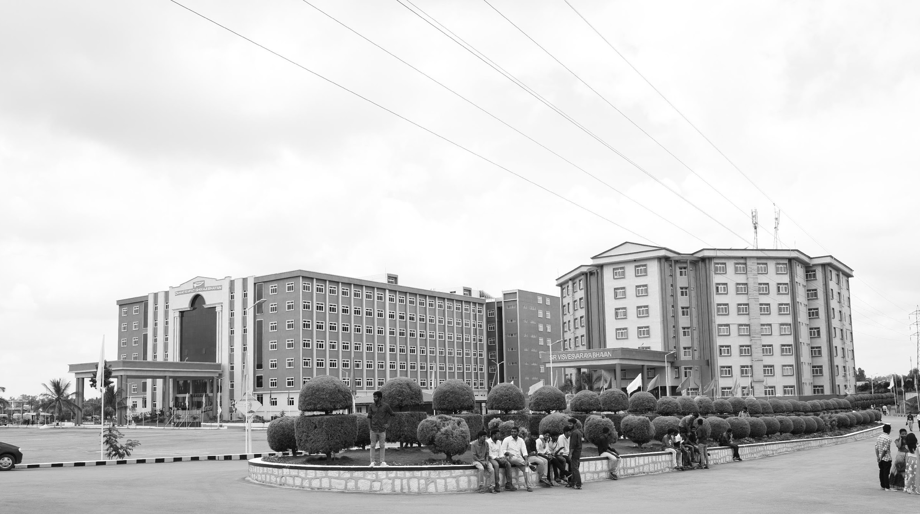

Harvesting Precision: Innovating Agriculture with Nano sensor RFID Tags for pH and Moisture Monitoring
AY 2021-25
GITAM UNIVERSITY
Major Project
Project ID: V5
A University should be a place of light, of liberty, and of learning.
Department of Electrical Electronics and Communication Engineering
Project Team:
MUDE VENKATA TEJA
GUDDITI SREE VANI
PALYAM LOKINI
Project Mentor:
LIGNESH DURAI Mentor
www.gitamedu.com

Slide 2


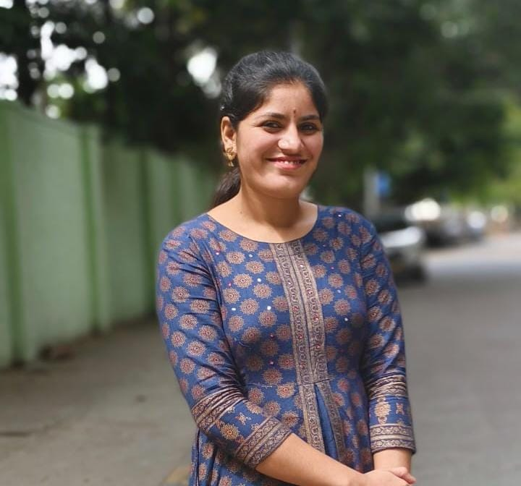
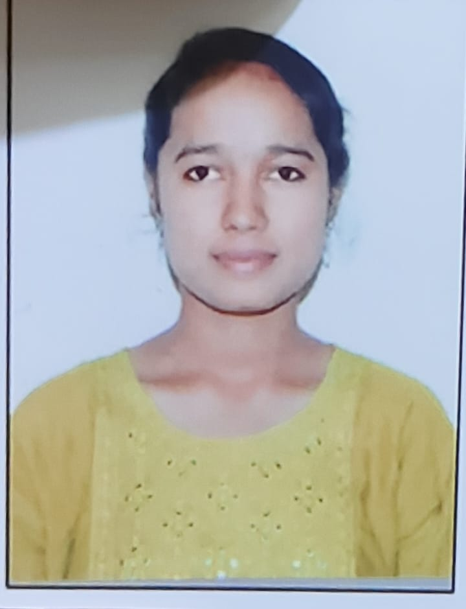
Project Group – Details
Photo
Track
Roll No
Name
EECE AI/ML
BU21EECE0100106
MUDE VENKATA TEJA
EECE AI/ML
BU21EECE010BU21BUBU21ECE0100430
GUDDITI SREE VANI
EECE
BU21EECE0100197
PALYAM LOKINI

Slide 3
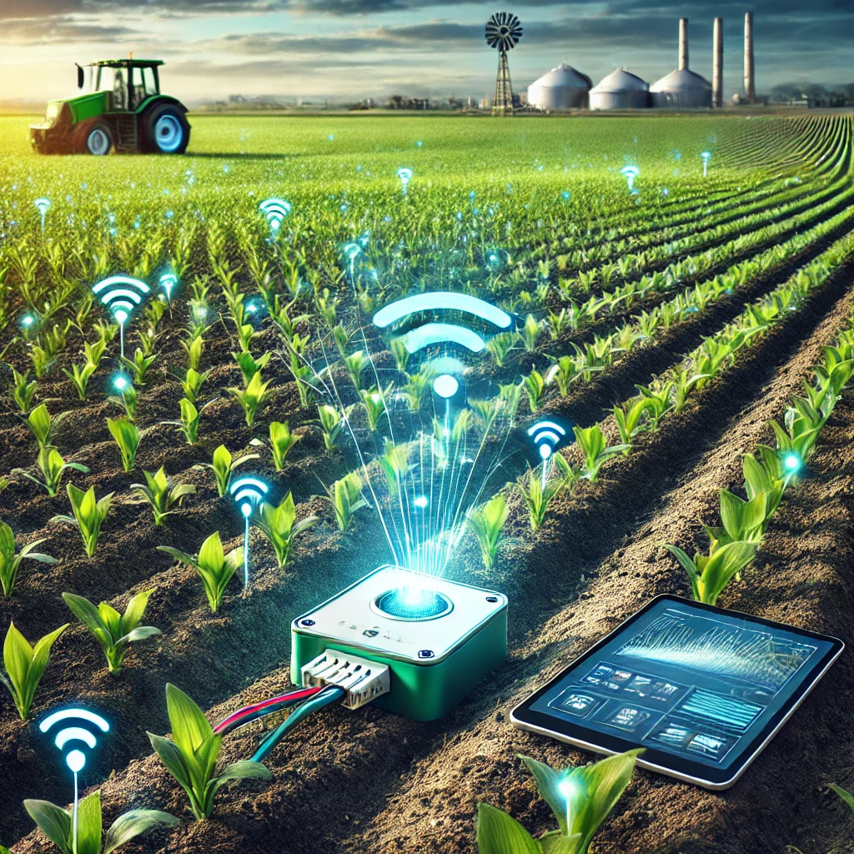
Objective and Goals
Objective
Develop an RFID-Enabled MXene-Based Conductometric Sensor.
Enhance Sensor Durability and Environmental Adaptability.
Improve Data Accuracy and Real-Time Monitoring.
Promote Sustainable Agriculture and Resource Management.
Goals
Main Goals
Durable RFID-Enabled MXene-Based Sensor
Precise Agriculture
Develop and Fabricate the sensor
Minimize Production cost
Additional Goals
User Friendly interfaces
Data-Driven Decision-Making
Technology Adoption in Diverse Regions

Slide 4
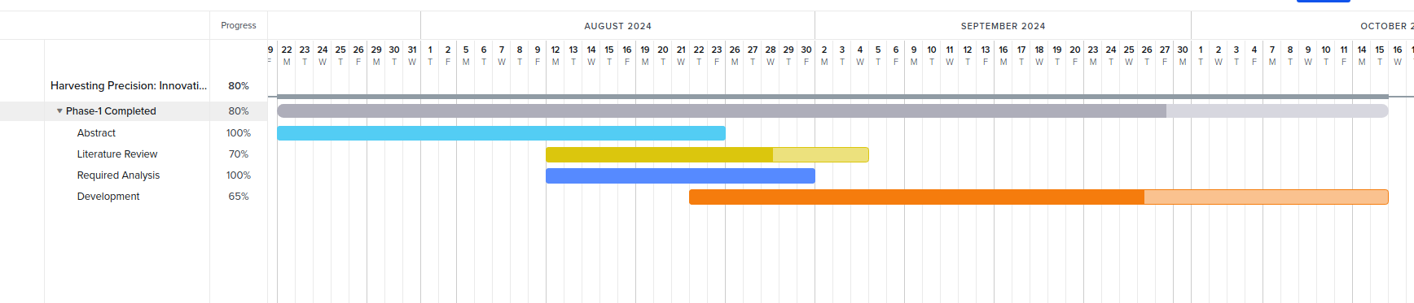
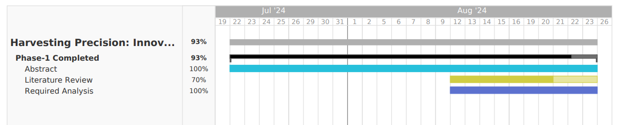
Project Plan

Slide 5
Literature Survey
Key Resources
IEEE Sensors Journal
Journal of Materials Chemistry A
Existing Implementations – Products| Opensource| GitHub etc
Wireless Sensor Networks (WSNs) in Agriculture
Tensiometer-Based Soil Moisture Monitoring
Key Publications – Whitepaper| Application Notes | Datasheet| Others
S.No | TITLE | AUTHORS | PUBLISHED YEAR | PUBLICATIONS | ABSTRACT
1 | Two-Dimensional MXenes for Energy Storage | M. Naguib, M. W. Barsoum, Y. Gogotsi, et al. | 2014 | Nature Reviews Materials | This paper introduces MXenes, a family of two-dimensional materials ideal for energy storage applications such as supercapacitors and batteries. Derived from MAX phases, MXenes offer high conductivity, flexibility, and a large surface area. The study demonstrates MXenes' superior energy storage capabilities compared to traditional materials like graphene.

Slide 6
Literature Survey
S.No | TITLE | AUTHORS | PUBLISHED YEAR | PUBLICATIONS | ABSTRACT
2 | Advanced Soil Sensors for Precision Agriculture | X. Li, L. Zhang, C. Li, P. Wang, et al. | 2018 | Trends in Biotechnology | The paper reviews advanced soil sensors that measure parameters like moisture, pH, and nutrients to optimize farming practices. It highlights the use of electrochemical, optical, and mechanical sensors, emphasizing their role in enhancing precision agriculture through real-time monitoring and wireless integration.
3 | Wireless Soil Moisture Monitoring Systems for Precision Agriculture | Q. Zhang, X. Liu, H. Wang, et al. | 2019 | Biosystems Engineering | This study discusses wireless soil moisture monitoring systems for precision agriculture. It highlights how wireless sensor networks (e.g., LoRa, ZigBee) enable real-time soil moisture tracking, improving irrigation efficiency. The authors address challenges like power management and communication range in large-scale agricultural settings.

Slide 7
Literature Survey
S.No | TITLE | AUTHORS | PUBLISHED YEAR | PUBLICATIONS | ABSTRACT
4 | MXenes: A New Family of Two-Dimensional Materials | M. Alhabeb, K. Maleski, B. Anasori, Y. Gogotsi, et al. | 2017 | Advanced Materials | This review explores MXenes, two-dimensional materials with tunable surface properties, high conductivity, and versatile applications. MXenes are synthesized by etching MAX phases, and their potential applications span energy storage, catalysis, electromagnetic shielding, and water purification, owing to their unique chemical and physical properties.
5 | Ni3C MXene nanosheets as an efficient binder-less electrocatalyst for oxygen evolution reaction | Aksha Gilbert Prince, Lignesh Durai, Sushmee Badhulika | 2022 | ELSEVIER | Low-cost, stable Ni-MXene electrocatalysts, synthesized via HF-free solvothermal etching of Ni-MAX, show promise for large-scale water-splitting. The NiMX/NF electrode achieves an overpotential of 245 mV at 100 mA/cm², with enhanced activity due to the Ni²⁺/³⁺ redox couple and carbon. The catalyst retains 83% current density after 14 hours, making it suitable for industrial oxygen evolution reaction (OER) applications.

Slide 8
Analysis - SWOT
Strengths
Weaknesses
W1. Technical complexity in sensor fabrication and integration.
W2. Need for extensive field validation across different regions.
W3. High resource requirements for development and deployment.
S1. Innovative use of MXene for sensor development.
S2. Real-time, accurate monitoring of soil pH and moisture.
S3. High adaptability to diverse environmental conditions
Threats
Opportunities
T1. Technological uncertainty and potential performance issues.
T2. Barriers to market adoption, particularly in traditional farming regions.
T3. Competition from alternative precision agriculture technologies.
O1. Advancement and standardization of precision agriculture technologies.
02. Promotion of sustainable farming practices.
O3. Potential for significant academic contributions and commercialization.

Slide 9
Analysis – 4W1H
Why:
To enhance agricultural productivity and sustainability by providing reliable, actionable data for optimal irrigation and fertilization.
What:
Development of an RFID-enabled MXene-based conductometric sensor for precise, real-time monitoring of soil pH and moisture levels.
Where:
Applicable globally, with initial focus on regions with significant agricultural activity and varying environmental conditions.
When:
The project aims to develop and deploy the sensor system within a specific timeframe, typically involving initial research and development over 12-18 months, followed by field testing and validation in subsequent phases.
How:
Fabrication and integration of MXene-based sensors with RFID technology, followed by extensive field validation to ensure performance across diverse conditions.
Refined Objective:
To advance precision agriculture by creating a versatile sensor system that not only monitors soil conditions but also integrates seamlessly into existing agricultural practices for improved crop management and resource efficiency.

Slide 10
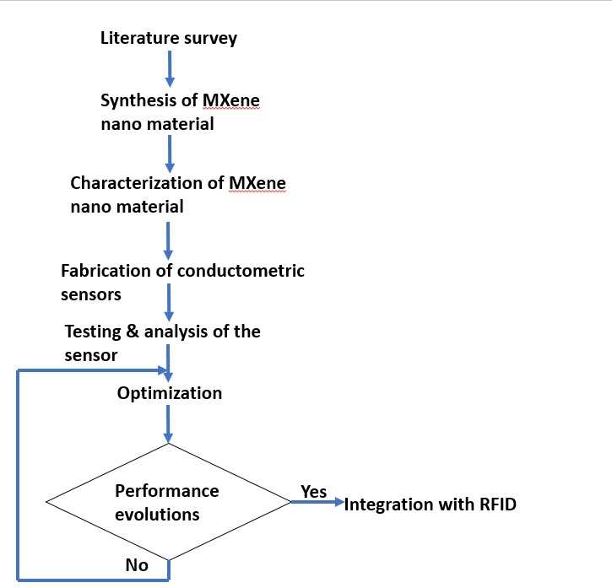
Architecture
Behaviour Diagram: FLOW CHART
Fabrication of sensor:

Slide 11
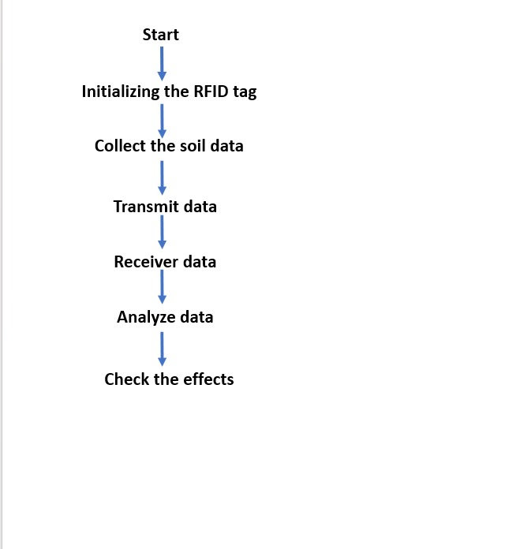
Architecture
Behaviour Diagram: FLOW CHART
Behaviour Diagram: FLOW CHART
Integration of sensor:

Slide 12
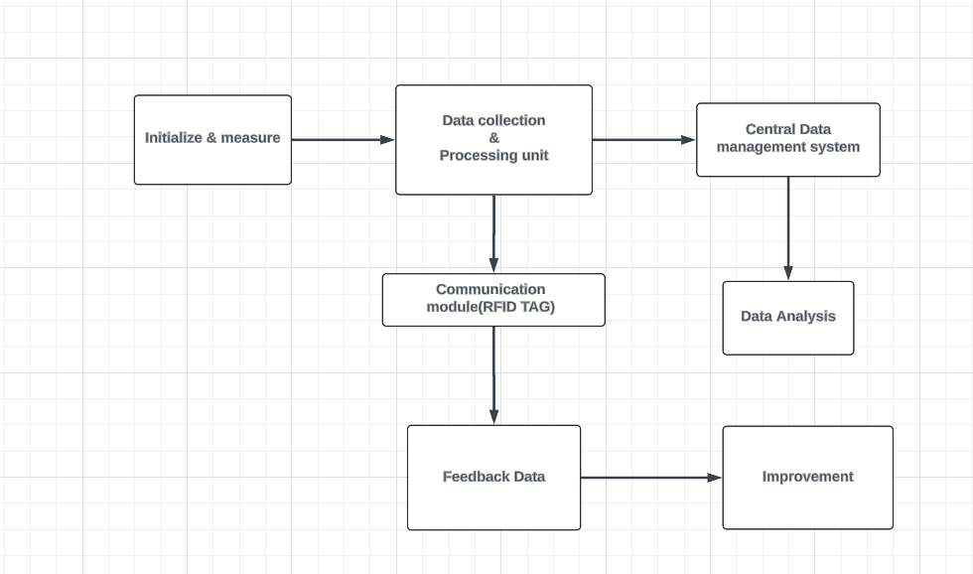
Architecture
Structural Diagram: Block Diagram

Slide 15
Use Cases & Testing
Use Cases
Xx
Xx
X
X
Test Cases
XX
XX
XX

Slide 16
Implementation and Results – Iteration 1
Iteration 1 : Results

Slide 17
Implementation and Results – Iteration 2
Iteration : Results + Validation against the usecases and test cases

Slide 18
Implementation and Results – Iteration 3 (Optional)
Iteration : Results + Validation against the usecases and test cases

Slide 19
Contribution
Team Progress and Movement
Xx
Xx
X
X
Individual Contribution
Key contributions: Team Member Name
XX
XX
Key contributions: Team Member Name
XX
XX
Key contributions: Team Member Name
XX
XX
Key contributions: Team Member Name
XX
XX
Key contributions: Team Member Name
XX
XX

Slide 20
Conclusion & Future Work
Summary and Conclusion
Future Work

Slide 21

THANK YOU

